Slide 1

San Francisco Real Estate Valuation
Naresh Kumar Mallela

Slide 2

Introduction: Opportunity in Crisis
San Francisco's real estate market has historically been one of the most competitive and expensive in the United States. Following the 2008 financial crisis, property values fluctuated significantly, creating uncertainty but also opportunities for investors willing to act strategically.
Market Impact
Home prices fell 20-30% during the crash, hitting their lowest point in early 2009
San Francisco Chronicle, 2014
Project Goal
The challenge: determine which properties are undervalued and most suitable for investment.
Design a data-driven framework to estimate property values and identify the best investment opportunities

Slide 3

Case Study: The Milton Campos Challenge
1
The Investor
Milton Campos, youngest son of a family who achieved financial success through their heavy equipment maintenance company
2
The Investment
Approximately $7 million allocated to purchase exactly three properties in San Francisco during August 2009 for medium-term profit
3
The Problem
Milton lacked expertise in both real estate and quantitative analysis, requiring data-driven guidance to identify optimal opportunities
4
The Solution
Apply regression analysis to estimate property values and identify the best investments by comparing estimated value against listed price

Slide 4
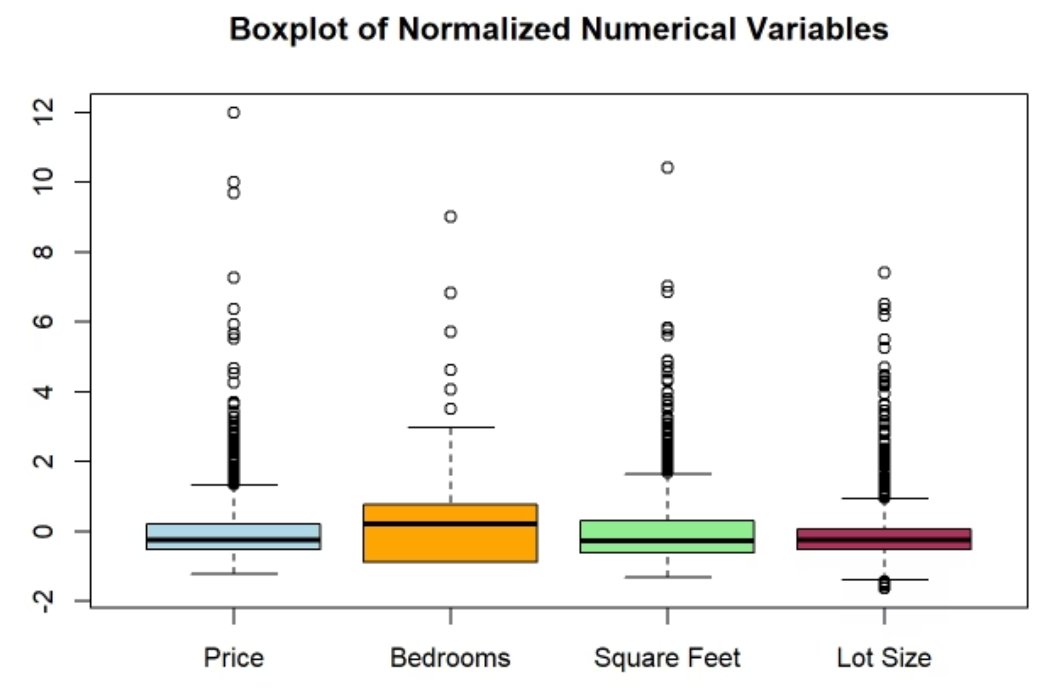
Initial Data Insights
Dataset Overview
The dataset encompasses house listings from February 20, 2008 to July 10, 2009, with prices ranging from $100,000 to $9,500,000.
Key Observation
Initial analysis indicates potential outliers, as maximum values for Price, Bedrooms, Square Feet, and Lot Size are significantly distant from their respective third quartile values.
These extreme values require careful statistical treatment to ensure model accuracy.

Slide 5




Outlier Handling Strategy
Identification
The identified outliers are valid observations representing legitimate high-end properties, not data entry errors
Treatment Approach
Cap extreme values at appropriate upper and lower thresholds based on IQR or percentiles to minimize impact on statistical models
Goal
Preserve data integrity while preventing outliers from disproportionately influencing regression coefficients

Slide 6

Models & Performance
Using R for Statistical Analysis

Slide 7

Model Preparation Process
01
02
Feature Selection
Data Splitting
Focused only on numeric and categorical variables relevant to model development, excluding non-informative fields such as ID and address
Dataset split into training and validation subsets using a 70:30 ratio to ensure robust model evaluation
03
04
Model Training
Validation
Multiple Linear Regression, Stepwise Regression, and Regression Tree models were trained on the training subset
All models were used to generate predictions for the validation data to assess generalization performance

Slide 8
Model Performance Comparison
RMSE comparison for three models on training and validation datasets, assessing accuracy and generalization.

Slide 9

Why Multiple Linear Regression Wins
Lowest RMSE
Strong Generalization
Multiple Linear Regression delivers the lowest and most stable RMSE across both training and validation sets, demonstrating superior predictive accuracy
The model's consistency reflects balanced performance that avoids overfitting while still capturing key relationships in the dataset
Optimal Simplicity
MLR provides strong accuracy without adding unnecessary complexity, making it the most dependable and interpretable choice among evaluated methods
Overall, Multiple Linear Regression emerged as the optimal model for identifying undervalued investment opportunities in the San Francisco real estate market.

Slide 10
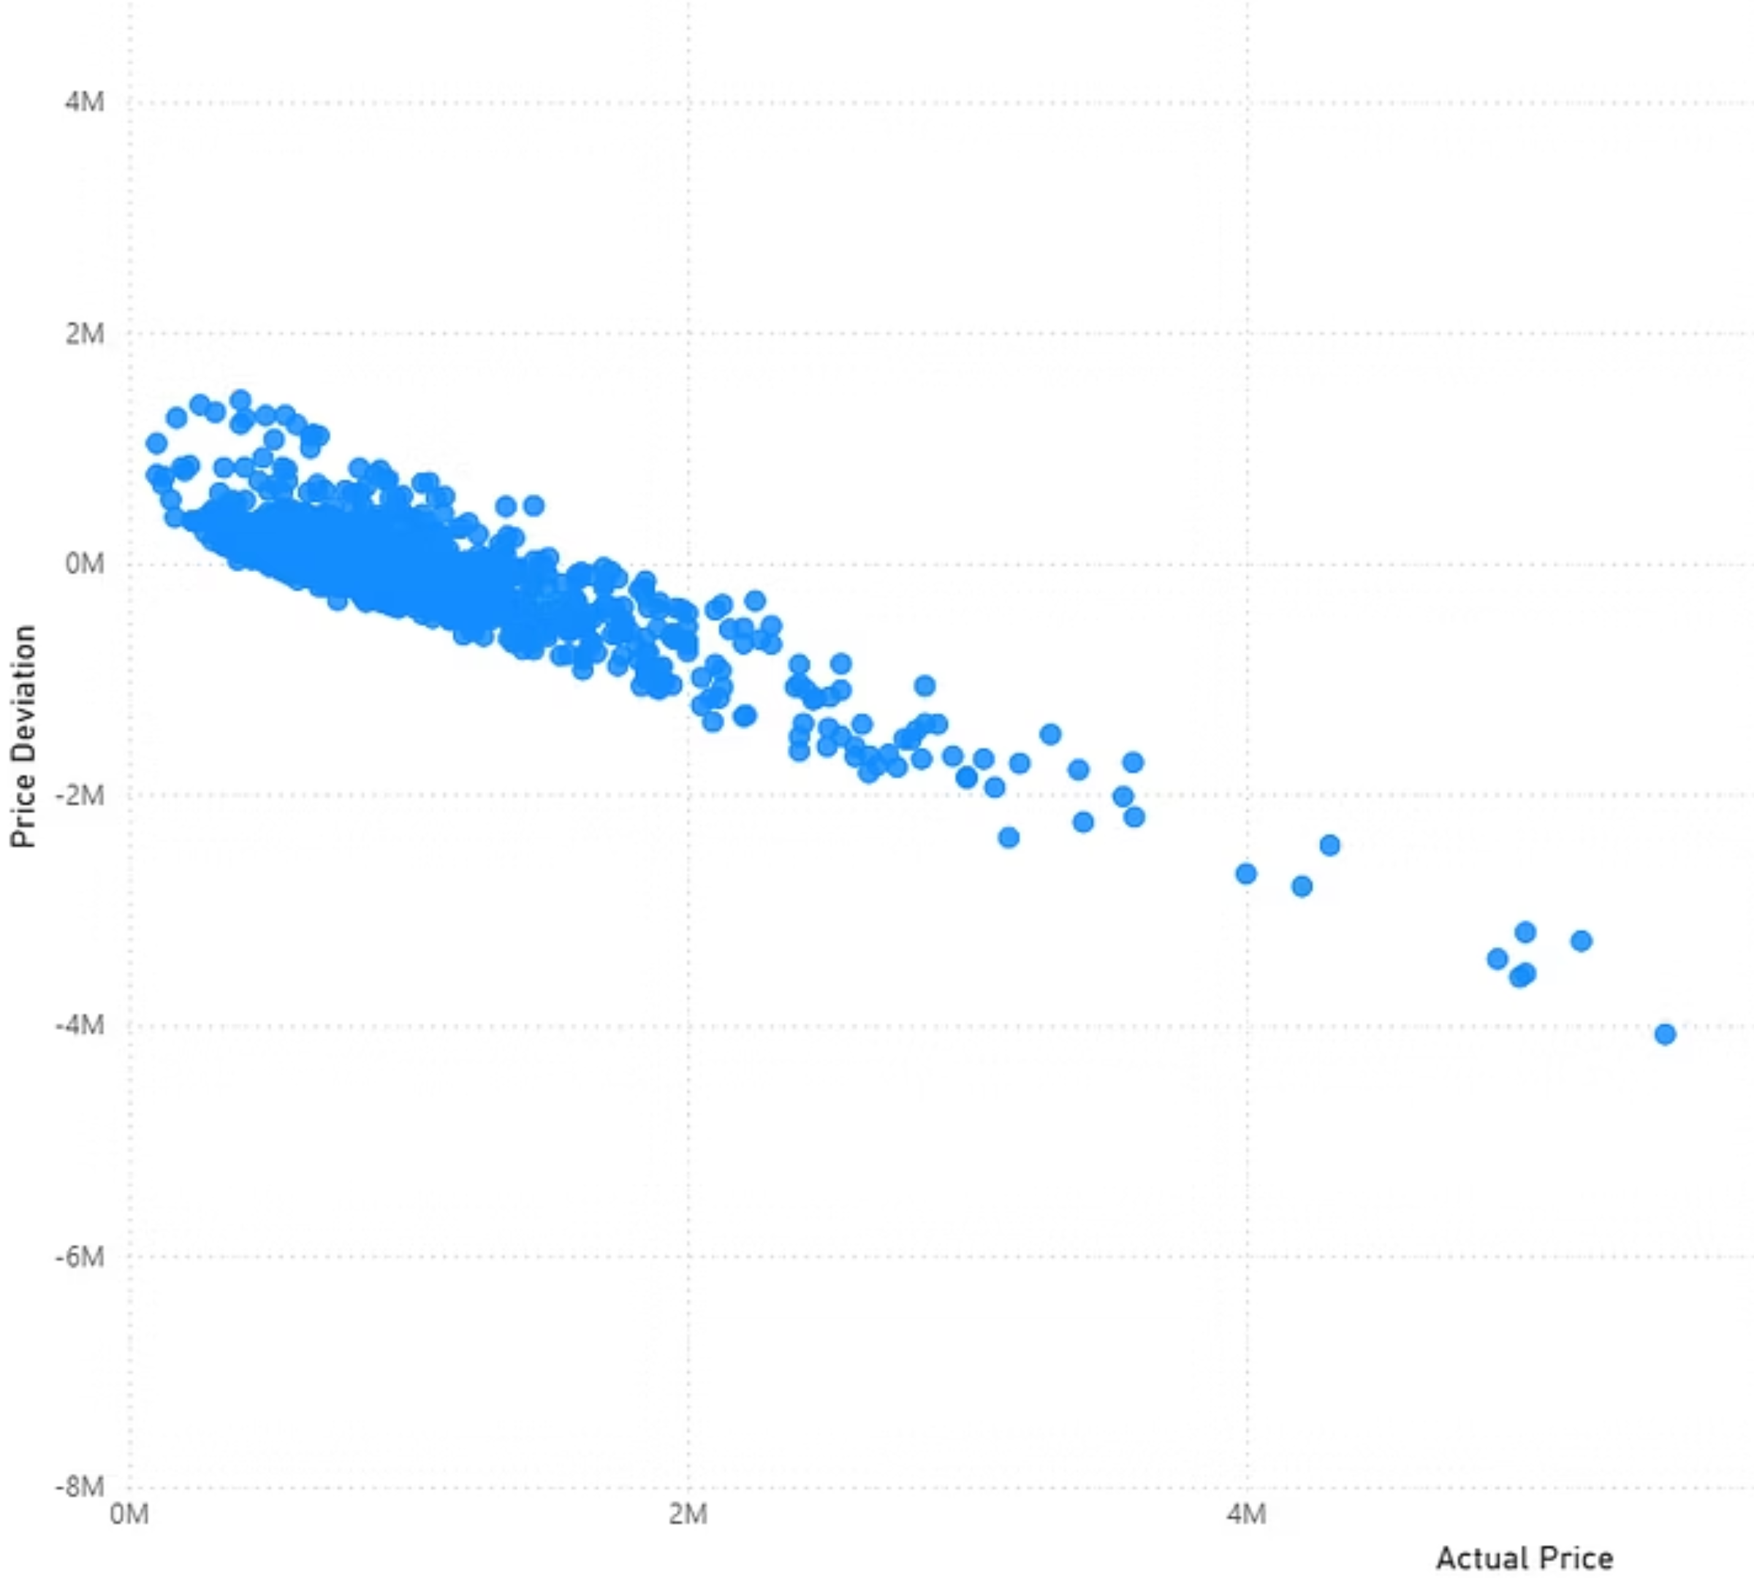

Price Benefit Analysis
Price Deviation Formula
Price Deviation = Predicted Price – Actual Price
This metric represents the estimated benefit that can be derived from each investment opportunity. Properties with positive deviation are undervalued relative to their predicted market value.
By visualizing price benefit against actual price, investors can quickly identify the most attractive opportunities where market value exceeds listing price—the foundation for Milton's three-property investment strategy.

Slide 11

Top 10 Houses Combination based on Price Deviation
Real Estate Investment Recommendations
ComboRank
ID1
ID2
ID3
ComboPrice
ComboDeviation
1
14
412
415
964500
4091635
Key Definitions
Combo Price = Sum of actual prices of three houses
2
14
412
744
1215000
4062160
Combo Deviation = Sum of deviations of three houses
3
14
412
1095
1145000
4059640
These metrics are calculated for combinations of three properties, providing a comprehensive view of potential investment opportunities.
4
14
92
412
826000
4038313
5
14
412
913
1073000
4034285
Investment Combos are ranked in descending order, indicating the most beneficial opportunities at the top and the least at the end. This allows investors to quickly identify and prioritize the most attractive property groupings based on their combined price benefits.
6
14
415
744
1269500
4001885
7
14
415
1095
1199500
3999365
8
14
412
559
1055000
3983867
9
14
263
412
1255000
3980022
10
14
92
415
880500
3978038

Slide 12
Conclusion
Multiple Linear Regression emerged as the most accurate
and a dependable valuation model.
2. Price deviation analysis helped find properties drastically undervalued in the post-crisis market.
3. While staying within Milton’s $7 million budget, the top three property combinations
offer the greatest possible return.
4. Overall, the data-driven strategy produces transparent, risk-aware, and profit-maximizing real estate investment

